Slide 1
Motifs in algebraic geometry
Aknazar Kazhymurat
NIS for Physics and Mathematics, Almaty
E-mail: fourier845@gmail.com

Slide 2
Why do we care?
There are a lot of cohomology theories in algebraic geometry (étale, derived functors, Čech, etc.). In most of situations they give essentially the same answers and its annoying that we do not any canonical cohomology theory. We would expect all those cohomologies to come from the unique cohomology theory defined over rationals but it can be shown that this is not the case.

Slide 3


How do we cope?
Grothendieck has suggested that there should be a category of motives, and a functor
so that every cohomology theory (which is basically a contravariant functor from the category of smooth projective varieties to graded K-algebras (K being the coefficient ring) factors uniquely through .

Slide 4
How do we get there?(Def. Of Coh.Th.)
A Weil cohomology theory is a contravariant functor [1] :
H*: {smooth projective varieties over a field k} → {graded K-algebras}
satisfying following axioms:

Slide 5
How do we get there? (Def. Of Coh.T.)
H^{i}(X) are finite-dimensional K-vector spaces.
H^{i}(X) vanish for i < 0 or i > 2n.
H^{2n}(X) is isomorphic to K (so-called orientation map).
There is a Poincaré duality, i.e. a non-degenerate pairing: H^{i}(X) × H^{2n−i}(X) → H^{2n}(X) ≅ K.
There is a canonical Künneth isomorphism:
H*(X) ⊗ H*(Y) → H*(X × Y).

Slide 6
How do we get there? (Def. of Coh.Th.)
There is a cycle-map: γ_{X}: Z^{i}(X) → H^{2i}(X), where the former group means algebraic cycles of codimension i, satisfying certain compatibility conditions with respect to functionality of H, the Künneth isomorphism and such that for X a point, the cycle map is the inclusion Z ⊂ K.
Weak Lefschetz axiom: For any smooth hyperplane section j: W ⊂ X (i.e. W = X ∩ H, H some hyperplane in the ambient projective space), the maps j*: H^{i}(X) → H^{i}(W) are isomorphisms for i ≤ n-2 and a monomorphism for i ≤ n-1.
Hard Lefschetz axiom: Again let W be a hyperplane section and w = γ_{X}(W) ∈ H²(X)be its image under the cycle class map. The Lefschetz operator L: H^{i}(X) → H^{i+2}(X) maps x to x·w (the dot denotes the product in the algebra H*(X)). The axiom states that L^{i}: H^{n−i}(X) → H^{n+i}(X) is an isomorphism for i=1, ..., n.

Slide 7
How do we get there? (Def. of Adeq. Eq. rel.)
An adequate equivalence relation [2] ~ is an equivalence relations on the P(k), the class of smooth projective varieties over k which is
Compatible with F-linear structure and graduation;
For any two A and B in P(k), A can be deformed without altering its equivalence class to A’ , so that A’ and B intersect properly.

Slide 8
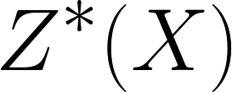
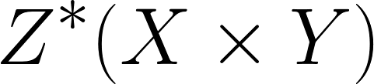

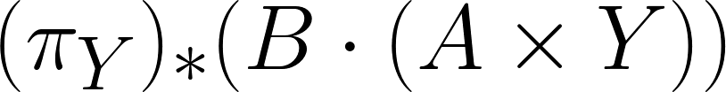
How do we get there? (Def. of Adeq. Eq. Rel.)
Let A in and B in be cycles such that intersects B properly. If A~_{X} 0, then ~_{Y} 0, where is the projection.

Slide 9
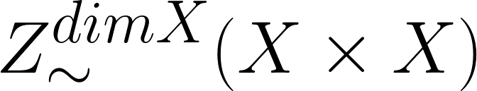
How do we get there? (Constr. Of )
We start with the category of smooth projective varieties and then take its pseudoabelian envelope, i.e. we adjoin kernels of idempotents [3]. The objects of are then of following form: triples (X,e,n) where X is a variety, e is an equivalence class of an idempotent correspondence , n- an integer.

Slide 10
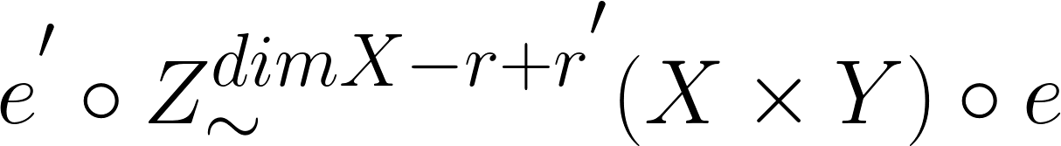
How do we get there (Constr. Of )?
The morphism in between (X,e,r) and (Y,e’,r’) is given by the data of cycle in:

Slide 11

What we expect it to be?
We expect that ; this is called the standard conjecture D. It implies that
is abelian semi-simple. [4]

Slide 12
What is proved?
U. Jannsen proved that is abelian and semisimple if and only if ~ is the numerical equivalence relation. [5]
Klozer proved that the conjecture D holds for abelian varieties over finite fields in l-adic cohomology for set of primes of positive density. [6]

Slide 13
References
[1]- Kleiman, S. L. (1968), "Algebraic cycles and the Weil conjectures", Dix exposés sur la cohomologie des schémas, Amsterdam: North-Holland, pp. 359–386;
[2]- Jannsen, U. (2000), "Equivalence relations on algebraic cycles", The Arithmetic and Geometry of Algebraic Cycles, NATO, 200 (Kluwer Ac. Publ. Co.): 225–260

Slide 14
References
[3]- Une introduction aux motifs by Yves André, 2004,Société mathématique de France;
[4]- Grothendieck, A. (1969), "Standard Conjectures on Algebraic Cycles", Algebraic Geometry (Internat. Colloq., Tata Inst. Fund. Res., Bombay, 1968), Oxford University Press, pp. 193–199;

Slide 15
References
[5]- Jannsen, Uwe. "Motives, numerical equivalence, and semi-simplicity." Inventiones mathematicae 107.3 (1992): 447-452;
[6]- Klozel, Laurent. “Equivalence numérique et équivalence cohomologique pour les variétés abéliennes sur les corps finis. ’’ Ann. of Math. (2) 150 (1999), no. 1, 151-163.

